Slide 1



Divisioning
Capital District Circle K International
Membership Development & Education Committee
April 2014

Slide 2
What is a Division?
Clubs that are located near one another within a district are grouped together in a division.
Each district can divide itself into as few or as many divisions as needed to best serve the members of the district.
We currently have 8 Divisions within the Capital District (with 3-6 clubs in each division):
-Battlefield
-Foothills
-Metro-Richmond
-NoVa
-Potomac
-Presidential
-Susquehanna
-Tidewater

Slide 3
Divisions Within the Capital District
Battlefield: Anne Arundel Community College, Hood College, and the University of Maryland: College Park.
Foothills: Hampden-Sydney College, Liberty College, Lynchburg College, Randolph College, and Virginia Tech.
Metro-Richmond: Randolph-Macon College, the University of Richmond, Virginia Commonwealth University, and Virginia State University.
NoVA: George Mason University, Marymount University, NVCC-Alexandria ,NVCC-Loudoun NVCC-Woodbridge, and the University of Mary Washington.

Slide 4
Divisions Within the Capital District
Potomac: The George Washington University, Howard University, and St. Mary’s College of Maryland.
Presidential: James Madison University, Mary Baldwin College, Shenandoah University, and the University of Virginia
Susquehanna: The Johns Hopkins University, Towson, and The University of Delaware.
Tidewater: Christopher Newport University, the College of William and Mary, and Tidewater Community College

Slide 5
Divisional Growth
As clubs grow and new clubs charter throughout the district, divisional lines have to be modified to best serve the members of the district.
This year, the Battlefield and Del-Mar divisions have been modified to form new and improved divisions: Battlefield and Susquehanna.

Slide 6
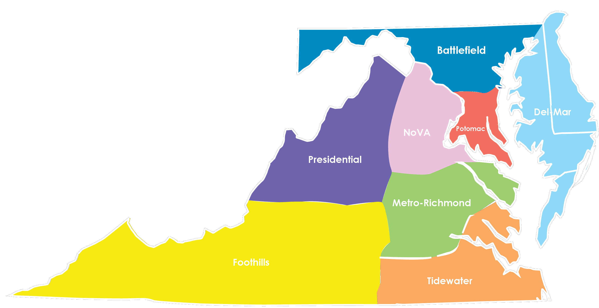
Old Divisions
Notes:
2013-2014 Capital District CKI Divisional Map

Slide 7
New Divisions
Towson and the Johns Hopkins University (formerly in Battlefield) will be joining the University of Delaware to form Susquehanna.
Anne Arundel Community College, Hood College, and the University of Maryland: College Park will remain in Battlefield.

Slide 8
Benefits of Divisions
Great opportunities for Interclub events!
Nearby resources and support outside of your club.
Open the door to make an even bigger impact on local communities.
Notes:
Interclubs: Interclubs are a great chance for you as a member of your club to meet other CKI members and share your passion and excitement for service with other people of a similar mind and attitude. It can be as simple as inviting the other clubs in your division to events you already have planned or asking to attend another club’s event. You don’t have to put in a ton or effort or go out of your way to form meaningful bonds with the other clubs in your division. Check out your division’s Facebook page to meet members from other clubs in your division and reach out to your LTG for help making connections!

Slide 9
Divisional Involvement
Have questions about your division or getting connected to the other clubs in your division? Contact your Lt. Governor to help plan a divisional event!

